Slide 1
SUSTAINABILITY STRATEGIES AT AECC Casey Shepard
October 5, 2018

Slide 2
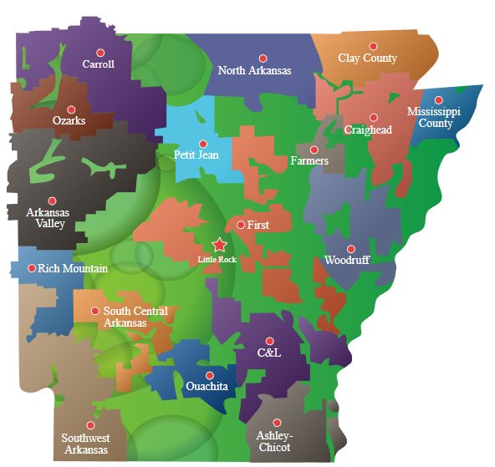
BRIEF OVERVIEW OF AECC
One of top generation and transmission cooperatives in U.S.
Owned by 17 distribution cooperatives
Provide electricity to 500,000 homes, businesses, farms
74 counties

Slide 3
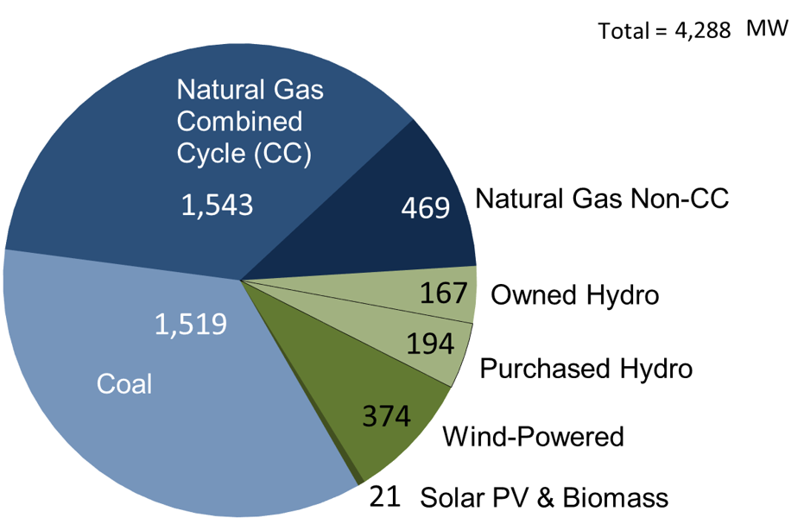
2017 CAPACITY BREAKDOWN
Sources of AECC Megawatts
Capacity in 2017
Total = 4,287 MW
Natural Gas = 47%
Coal = 35.4%
Hydropower = 8.4%
Wind = 8.7%
Solar/Bio = 0.5%
Notes:
Expect renewables and gas to continue to grow as coal becomes less favorable; Market forces & growing environmental awareness among consumers have made natural gas and renewable sources a bigger part of the generation mix

Slide 4


WHAT IS SUSTAINABILITY?
“To create or maintain conditions under which humans and nature can exist in productive harmony to support present and future generations.” – U.S. EPA

Slide 5
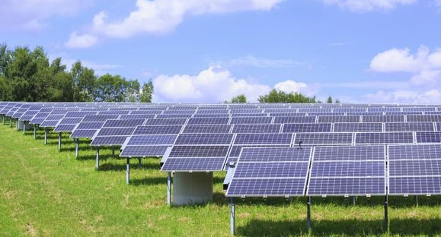

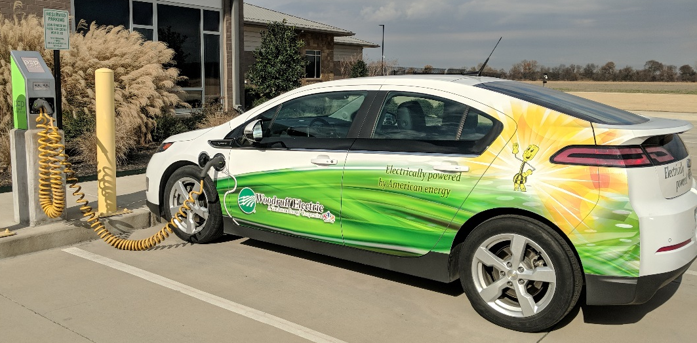
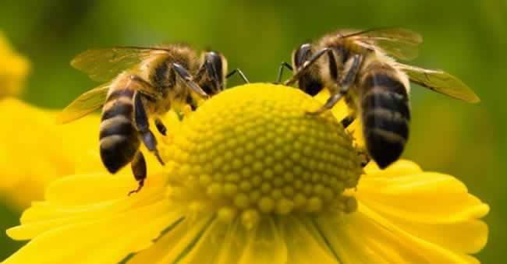
EXAMPLES
Notes:
Renewable Energy – move away from dependence on fossil fuels. As oil wells dry up, it will be more expensive to obtain, which will affect the supply chain – food, fuel, consumer goods. Have to explore other means to power our cities, businesses, and cars. Today want to discuss smaller picture.

Slide 6
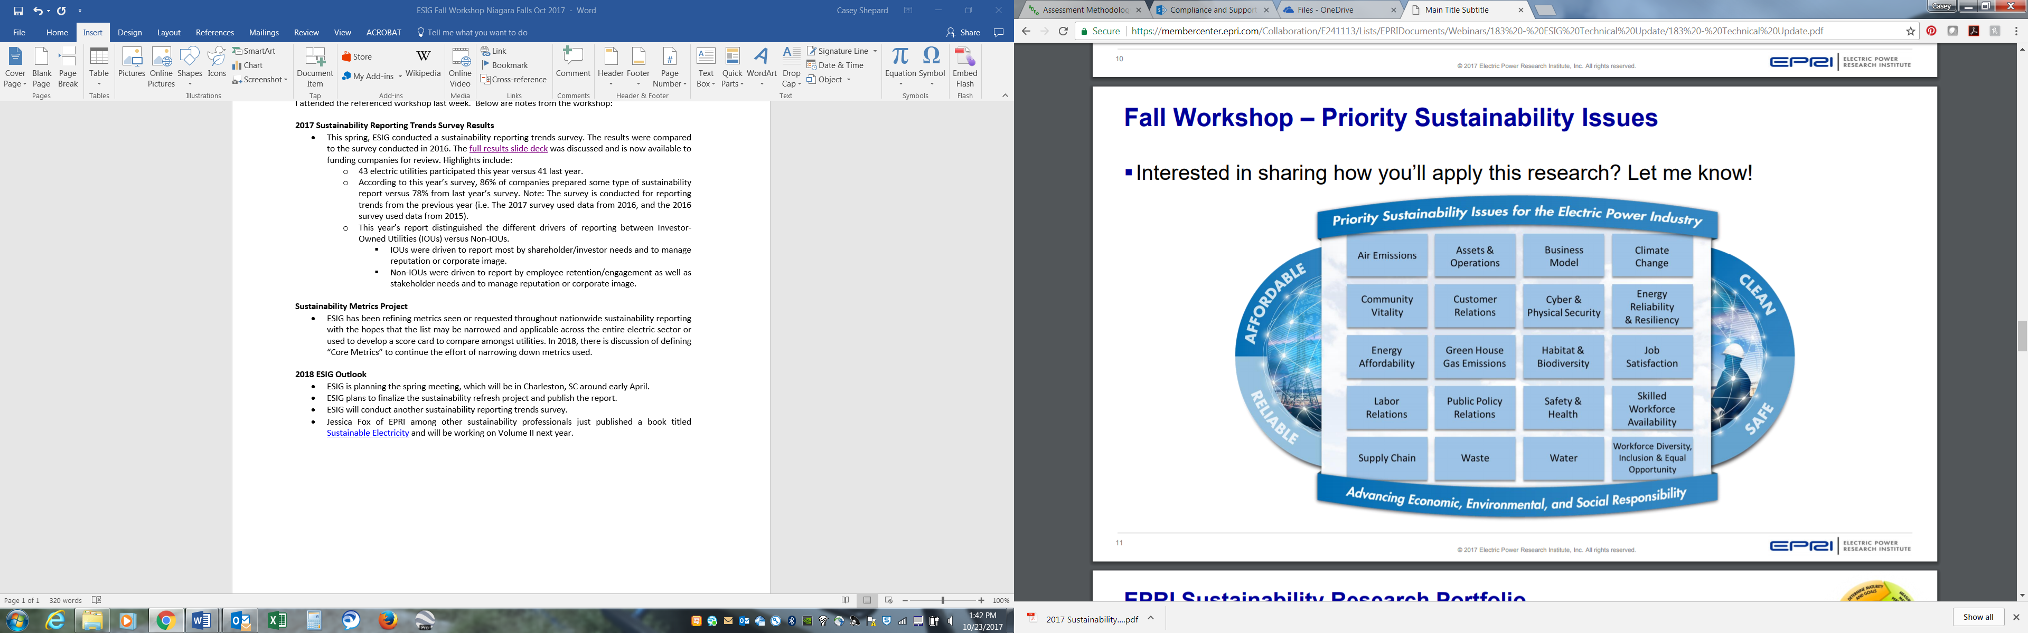
TRIPLE BOTTOM LINE MINDSET
Notes:
400 metrics narrowed down to 20 issues; fall under one or multiple issues or one or more of the 3 pillars of sustainability = TBLM, considering sustainability across all 3 pillars (people, planet, profit)

Slide 7
HOW TO GET STARTED
First and foremost – must obtain executive support
3-question survey to campus to gauge interest
Do you think a Sustainability Team would be beneficial to the organization?
Would you be interested in joining a team that implements sustainable workplace and community initiatives?
If so, could you commit one hour per month for a team meeting?
Disclose name
Review results with executive sponsor
Notes:
Yes/No/Unsure & open response for comments after each question – some asked for more specifics but really looking for overall impressions

Slide 8
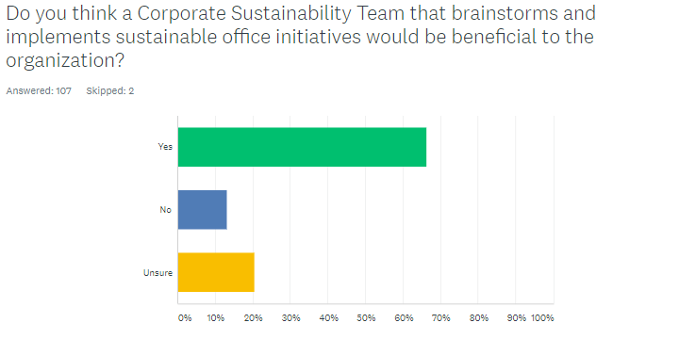
SURVEY RESULTS
Notes:
66% respondents felt the team would be beneficial, 21% unsure, only 13% said no; about 30% disclosed interested in joining team (27)

Slide 9

BUILDING A SUSTAINABILITY TEAM
Start small but aim big
Must be multi-departmental
Engineering, Building & Grounds, Records, Accounting, IT, Safety, Legal
Select potential teammates with sponsor
Email invitation to join
Email uninvited respondents to thank for their support and keep in mind for future initiatives
Set up first team meeting!
Notes:
Responses overwhelmingly diverse; Important to have different perspectives

Slide 10
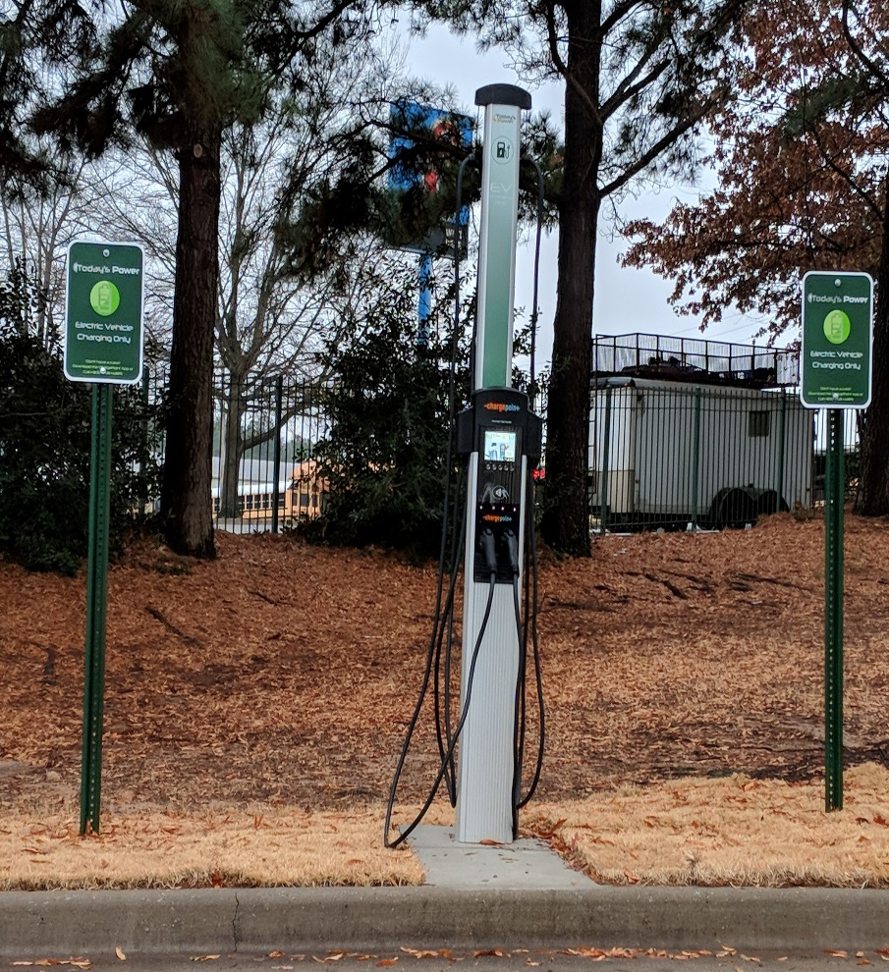
FIRST MEETING AGENDA
Welcome, Introductions, Background, Current Status
EV charging stations were recently installed
Building & Grounds acquiring recycling dumpster
First team initiative: champion launch of new recycling program
Sustainability Team Development
Discuss a team name: Cooperative Green Team
Obtain input to develop a Team Charter
What is our mission? Purpose? Goals? Deliverables?
Perhaps discuss Bylaws
Membership guidelines? Officers? Duties?
Discuss Potential Initiatives
Low- or no-cost
Feedback: What Role Do YOU Want to Play?
Notes:
Voluntary – no budget – coop, no pressure from stakeholders – no Sustainability dept. – no GRI reporting requirements

Slide 11
CHARTER DEVELOPMENT
What is a green team?
Group of employees who have committed to:
Reduce the organization’s environmental footprint;
Enlist co-workers as partners in promoting sustainable business practices;
Uphold concern for community; and
Further organizational mission to be reliable, affordable, and responsible.
What is our purpose?
Demonstrate leadership in environmental stewardship;
Create and foster a common understanding of green practices; and
Establish, measure, and report goals

Slide 12

CGT “SMART” GOALS
SMART =
Specific, Measurable, Attainable, Relevant, Timely
Increase recycling from 20% to 40-50% of total waste over the next 5 years
Reduce consumption by at least 10% in the areas of waste, energy, water, fuel, and emissions over the next 5 years
Continuously document sustainable metrics to allow comparison of efforts year-to-year
Implement one community-oriented and one workplace-oriented initiative each quarter
Notes:
Deliverable – report to senior staff by the end of the first quarter of the following year (2018 activities reported by end of March 2019)

Slide 13
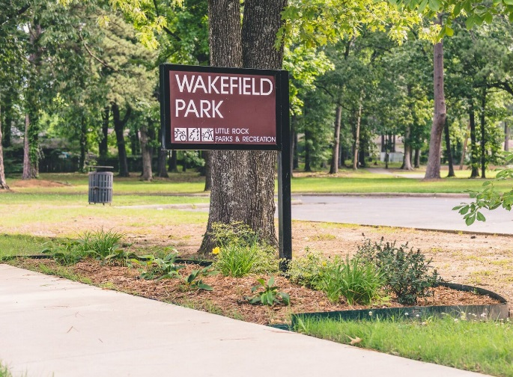
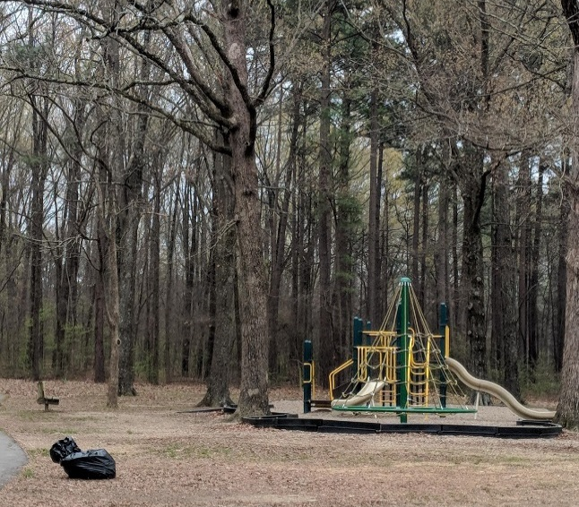
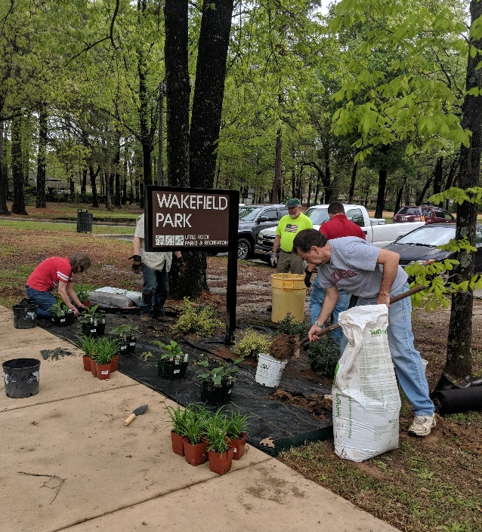
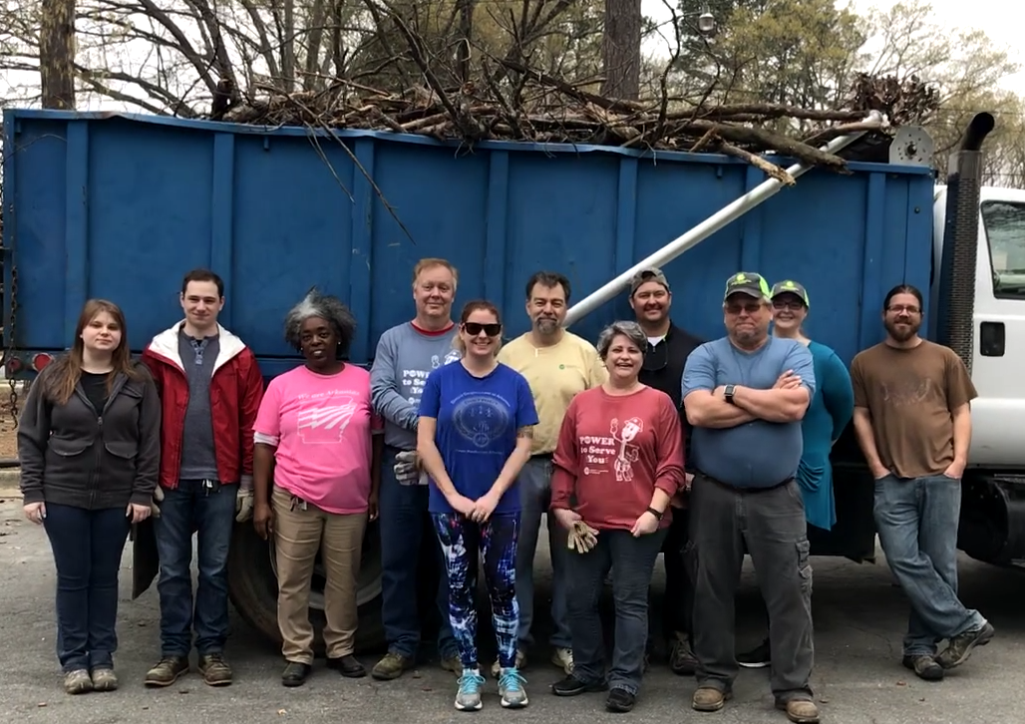
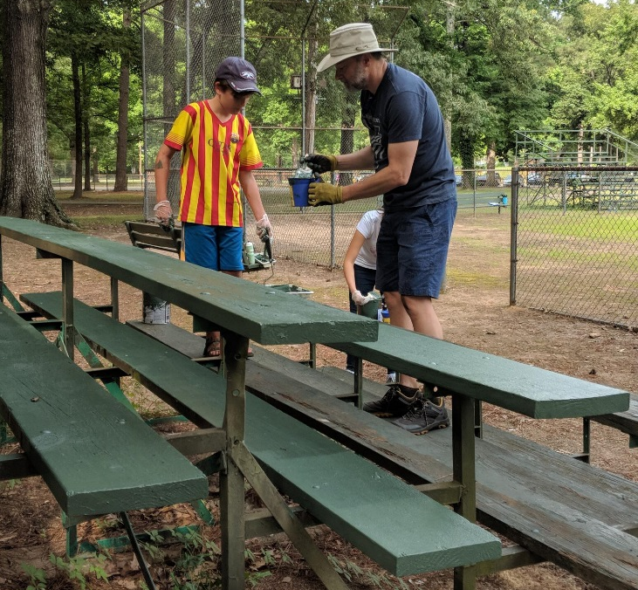
2018 COMMUNITY INITIATIVES
Adopted nearby Wakefield Park
Performed monthly cleanups from Mar. – Oct.
Installed and maintain a pollinator-friendly garden
Notes:
City of LR Parks & Rec Dept provided supplies/plants

Slide 14


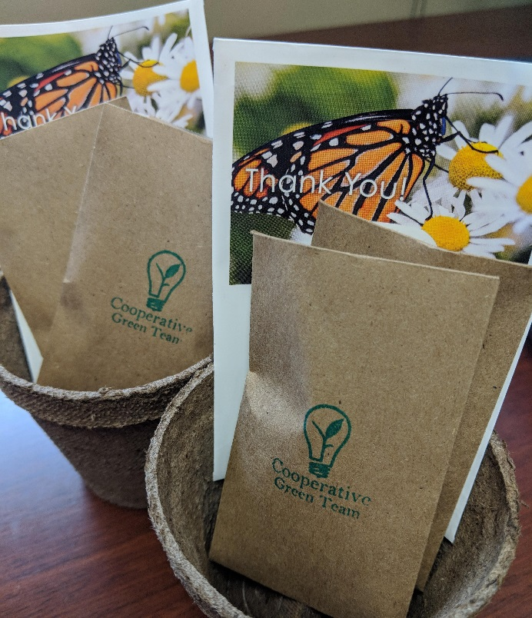
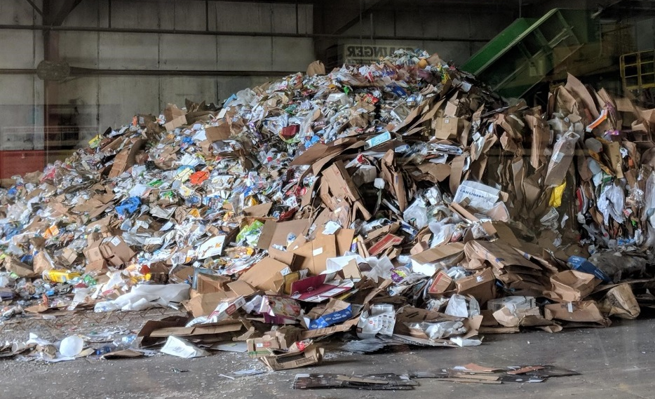
2018 WORKPLACE INITIATIVES
Workplace
Q1: Recycling Launch & Education
Q2: Pollinator Trivia & Seed Packets
Q3: Water Conservation & Quality
Q4: Promote Reusables
Notes:
Monthly recycling tip – Ex. plastic straws: the company store ordered stainless steel straws, which sold out in 45 minutes;

Slide 15

SUPPLEMENTAL TOPICS & EVENTS
World Water Day – March 22
Earth Day – April 22
E-waste recycling event – 300 lbs. to Goodwill
KLRB Great Arkansas Cleanup – September 8
Recruitment video
Notes:
Additional 220 lb recycled to date

Slide 16
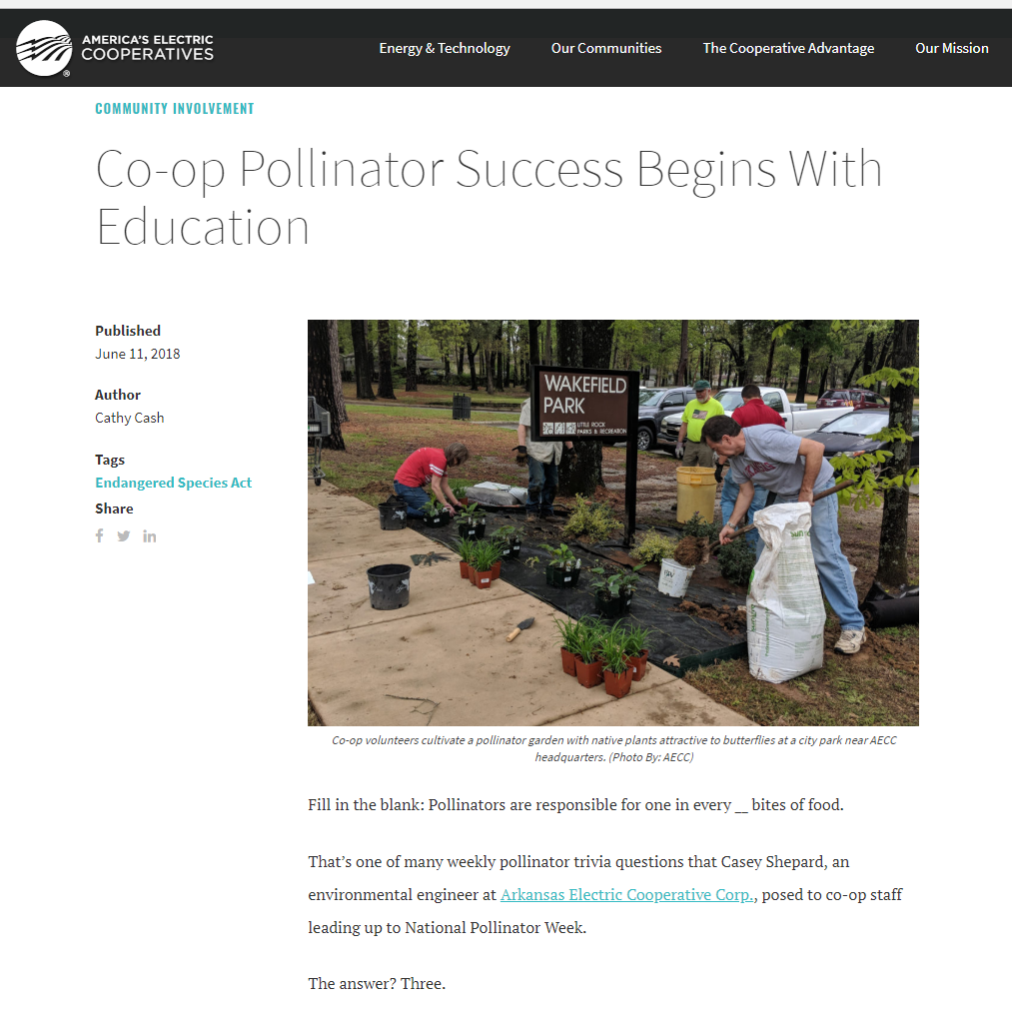
NATIONAL RECOGNITION
Notes:
National recognition for our efforts in June National Rural Electric Cooperative Association article
Expanded article to resurface in AWF fall or winter magazine

Slide 17

IN THE WORKS
Campus pollinator plot
Native gardening project with nearby elementary school
Community garden
Survey campus to determine 2019 initiatives
Revisit pollinators
Rideshare promotion
Stormwater
Energy conservation
Print Free Friday
Photo contest on Sustainability with grand prize

Slide 18

KEYS TO SUCCEED
Engage with your audience and survey their interests
Be flexible
Don’t try to do too much too quickly
Keep it simple and clear
Provide positive reinforcement
KEEP GOING

Slide 19
THANK YOU!
Casey Shepard
501-570-2102
casey.shepard@aecc.com

